Slide 1
Email Analysis
CS 225 Final Project
Alma Zirojevic, Jaime Gleason, Jessie Wang, Zayn Khan

Slide 2
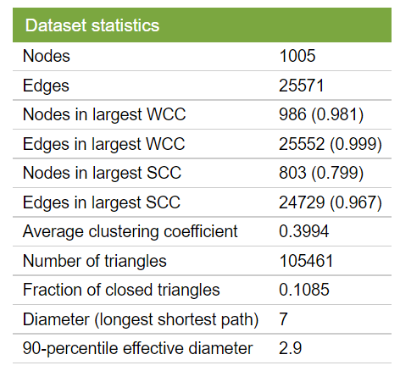
Our Dataset
Called email-Eu-core, included in Stanford University’s dataset collection
Email data from a large European research institution
Only internal emails
Two files: one mapping users to users and one mapping users to department
Two users are “mapped together” if there is at least one email sent between them
Notes:
Background: For our project, we have chosen to use the email-Eu-core network, included in Stanford University’s dataset collection. This dataset represents a research institution’s employees as nodes and the emails sent between them as edges.

Slide 3
Our Proposal
Leading Question: How can the email network of a research institution demonstrate its members’ interactivity and collaboration patterns?
Adjacency List Representation - to optimize storage space and access a node’s neighbors without querying dataset in O(V) time
Algorithms:
BFS - to find the number of connected components within a department
Dijkstra's - to find the shortest path between two inputted users
Hierholzer’s Eulerian cycle detection - to identify if email connections graph can be called Eulerian; if so, determine the Eulerian path
Notes:
Leading Question: How can the email network of a research institution demonstrate its members’ interactivity and collaboration patterns?
Algorithms:
Graph Representation - Our Graph constructor takes in a file of emails and departments, where nodes are individuals represented by two int values, their user ID and a department ID. These are then connected together by unweighted edges that are the representation of an email between two users, either in the same or different departments.
BFS - Using BFS, we wanted to determine the number of connected components within a given department. The search would function similarly to a regular BFS, but only users belonging to the inputted department ID would be considered.
Dijkstra's - Dijkstra’s algorithm would yield the shortest path between two inputted users, returning a vector of the email “steps” from user one to user two. Taking a step further, we wanted to determine the average length of the shortest path between two users, constrained to a given department. This second goal would not be user-interactive, just an exploratory exercise for our team
Hierholzer’s - Hierholzer’s is an algorithm that determines a graph’s Eulerian cycle, if it exists. We wanted to see if the research institution’s email network could be considered Eulerian and practice more complex graph algorithms.

Slide 4
Development Process
Chose dataset and submitted our project proposal
Implemented our graph structure using an adjacency list, parsing the given CSVs to populate it with user/email data
Received feedback on our proposal and re-evaluated the motivations of our project for resubmission
Constructed a Makefile
Wrote and tested our three central algorithms using dummy data
Notes:
The first week we chose our dataset and wrote our proposal.
Then we decided to use an adjacency list to store our data as it would be easiest to access the neighbours this way. The following week we received feedback on our proposal and had to make some changes in our approach to the data. While we were writing and testing our algorithms, we were also working on our makefile, which we had a lot of issues with, mostly with integrating catch2. After switching to cmake, we were able to test with our dummy data, a watered down version of the main dataset that was easier to visualize. Finally, we wrote our main so that a user could use our algorithms themselves

Slide 5
Concluding Insights
BFS - We ran BFS on each department (0-41), most departments had less than five connected components. However, departments 6, 21, and 23 had 12 or more connected components.
Dijkstra’s Algorithm - We found the average shortest path between users in Department 37 was 1.42857 people
Eulerian Cycle (Hierholzer’s Algorithm) - There is no Eulerian cycle.
Notes:
First, with BFS we were able to discover that some departments were more centralized than others. In our own examination of the data, we ran BFS on each department. Many of the departments were highly centralized, with five or fewer connected components. This makes sense as a research institution requires inter-departmental correspondence to collaborate and share ideas. Departments 6, 21, and 23 had 12, 16, and 12 connected components, respectively. The relative lack of centralization in these departments may indicate reduced staff collaboration.
In our Dijkstra’s Algorithm, we decided to examine the average shortest path of a random department, which was 37. For every user in that department we calculated the average length of path using our Dijkstra’s function. The average shortest path between any two users in Department 37 was 1.42857 people.
In addition, we discovered that there is no Eulerian cycle within our dataset. However, we tested our algorithm on a dummy dataset with an Eulerian cycle to ensure the algorithm runs correctly. The output of our Eulerian cycle detection is unsurprising, as it only requires one or more than two researchers to send an odd number of emails for isEulerian to return false. By the end of our examination, we determined that Eulerian cycles would be very unlikely in an email network such as our chosen dataset.

Slide 6


DEMO!!! + Final Thoughts
Queue.push(JaimeGleason);
Queue.push(AlmaZirojevic);
Queue.push(JessieWang);
Queue.push(ZaynKhan);
Notes:
Jaime: I feel like I’ve learned a lot about how to create graphs from a real-world dataset. I personally feel a lot more confident in my ability to write algorithms gleaning interesting insights from these datasets. If I were to redo the project, I think I would have chosen a more detailed / widely applicable dataset and potentially transform the idea into a larger, ongoing project.
Alma: The project really helped with learning how to create a feasible timeline. I also implemented user input to the terminal for the first time. If we had more time and stronger computers, I think it would be cool to see our functions used on larger and more applicable datasets
Jessie: The process of building a project from scratch was a good experience because it mimics an industry setting. I definitely learned alot and utilized many outside references for this project. I agree with Jamie in that our project scope was narrow since our dataset wasn’t super detailed, so I agree with choosing a dataset more applicable in the future.
Zayn: I definitely enjoyed this project. Working with a team to create actual insights from a dataset was very interesting. I learned a lot about Makesfiles and how we can construct graphs to model real sets of data. If I were to redo this project, I would have spent several hours less trying to get Makefiles to work, and just have started with CMake from the very beginning.

